Slide 1
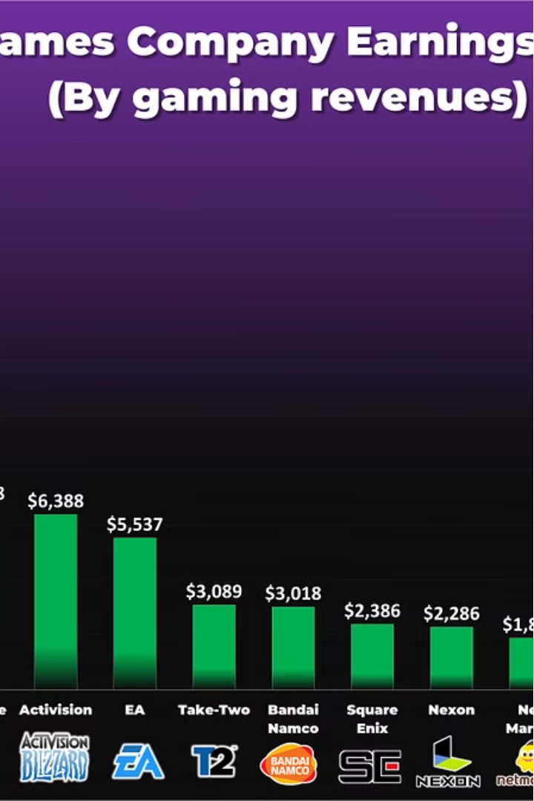

Introduction to Video Game Sales Prediction
Video game sales are a complex and dynamic industry, with many factors influencing consumer demand. Accurately forecasting sales is crucial for developers, publishers, and retailers to make informed decisions, optimize inventory, and maximize profitability.

Slide 2
Leveraging Data Visualization for Accurate Forecasting
Historical Trends
Market Segmentation
Competitive Landscape
Analyzing past sales data can uncover patterns and seasonality, helping predict future performance.
Identifying key customer demographics and their preferences allows targeted marketing strategies.
Tracking competitors' releases and market share provides valuable context for sales projections.

Slide 3
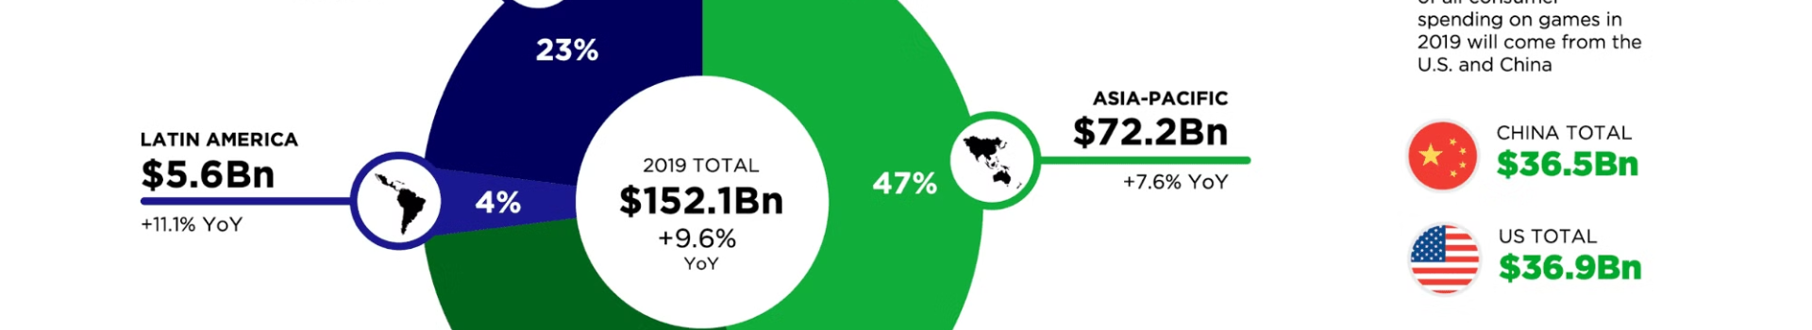
Key Challenges in Video Game Sales Prediction
1
Volatile Market Trends
2
Limited Historical Data
3
Unpredictable Hype Cycles
The video game industry is highly dynamic, with rapidly changing consumer preferences and industry disruptions.
New game franchises and platforms can lack sufficient sales data to reliably predict future performance.
Viral marketing, influencer campaigns, and word-of-mouth can dramatically impact a game's sales trajectory.

Slide 4
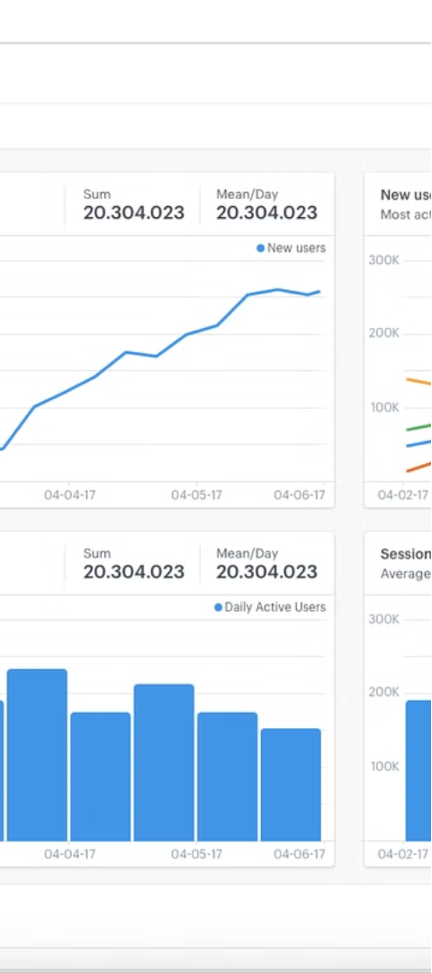
Importance of Data-Driven Decision Making
1
Informed Budgeting
Accurate sales forecasts enable developers to allocate resources effectively and minimize financial risk.
2
Optimized Marketing
Data-driven insights guide targeted marketing strategies to reach the right audience at the right time.
3
Competitive Advantage
Leveraging predictive analytics can give video game companies a strategic edge in a crowded market.

